Slide 1
2021-2022 Town Hall Meeting for Faculty & Staff
March 17, 2022

Slide 2
Land Acknowledgment
On behalf of the Seattle College, we acknowledge that we occupy the traditional ancestral lands of the Coast Salish peoples, specifically the Duwamish Tribe—a people that are still here, continuing to honor and bring to light their ancient heritage.
Without them/us, we would not have access to this gathering, dialogue and learning space.
We ask that we take this opportunity to thank the original caretakers of this land who are still here.

Slide 3
Labor Acknowledgement
Today in this Present Moment, we honor the survival, the adaptations, the forced assimilation, and the resilience and creativity of Native peoples – past, present, and future.
We encourage participants to consider their responsibilities to the people and land, both here and elsewhere, and to stand in solidarity with Native, Indigenous, and First Nations People, and their sovereignty, cultural heritage, and lives.
We recognize that enslaved and indentured peoples were forced into unpaid and underpaid labor in the construction of this country, state and city.
To the people who contributed this immeasurable work and their descendants, we acknowledge our/their indelible mark on the space in which we gather today.
It is our collective responsibility to critically interrogate these histories, to repair harm, and to honor, protect, and sustain this land.

Slide 4
Overview
Kudos
Update
Q&A

Slide 5
Kudos!
Guided Pathways advising re-design
Dr. Eric Greer, Kao LéZheo & Scott Rixon
Newly tenured faculty
Anna Hackman, Humanities
Ruby Hansra, Counseling
Janet Hinson, Community Health
Bliss Holloway, Visual Media
Scot Moy, Apparel and Design
Janine Buis, Nursing
Katie Gourd-Ascencio, Nursing

Slide 6
Campus Events
Seattle Colleges Foundation Scholarship
Applications are due April 13, 2022
For more information see: https://foundation.seattlecolleges.edu/scholarships
Welcome Week at Broadway Edison
April 4-7
For more information, contact Dennis Denman at Dennis.Denman@seattlecolleges.edu
Virtual Students of Color Conference
April 21-22
For more information, contact Mikaila Harris at Mikaila.Harris@seattlecolleges.edu
Notes:
Connect Central: Virtual Speed-Networking Week
Monday, January 31 to Thursday, Feb 3, 2022
Sessions daily at 10:30 a.m., 1 p.m., 2 p.m. and 5 p.m.
*Each session will include three 15-minute networking rounds.
More info at: seattlecentral.edu/connectcentral
Business and Accounting/ Culinary, Hospitality, and Wine - Monday, Jan. 31, 2022
Arts, Design & Graphics, Humanities & Language - Tuesday, Feb 1, 2022
STEM - Wednesday, Feb 2, 2022
Health & Medical, Education & Human Services/ Social Sciences - Thursday, Feb 3, 2022

Slide 7
Environmental Health and Safety Update
Bella Garrison, Director of Compliance
At this time, there have been no changes to Seattle Colleges COVID precautions
King County transmission levels
For more information see: https://kingcounty.gov/depts/health/covid-19/data/community-level.aspx
Endemic
For more information see: https://www.publichealth.columbia.edu/public-health-now/news/epidemic-endemic-pandemic-what-are-differences

Slide 8
Budget Update
- Colleges preliminary budget due 4/8
- anticipating 13% reduction across FY 21-22 and 22-23
- currently planning for college budget forum in April (virtual)

Slide 9
Spring 2022 Student Services Hours of Operation
Student Services will be open to the public for in-person services from 8:00am-4:30pm, Monday - Thursday.
On Fridays, all services will be offered virtually with the exception of Financial Aid, Testing, and Accessibility Resource Services.
Certain departments may have limited staffing, so please check department websites for specific in-person and virtual services. Note: due to staffing shortage, Counseling Center will be fully virtual until further notice.

Slide 10
Guided Pathways: Align Funding to Principles and Goals
Foundations
Black Solidarity Think Tank
Student Voices
Data dashboards
Open funds for students and employees
Clarify the Path
Entry and admissions specialist
Financial Aid specialist
+3 advisors (reduce caseload)
Running Start advising
Transitional Studies navigator
Counseling
Math curriculum and co-requisite models
Help students choose a Path
Math Directed Self Placement
Mapping and new program pathways webpages
New Program brochures and videos
Keep Students on the Path
Funding and resources specialist, student support programs
New Umoja program
Orientation to College Success Class
Ensure Learning
Assessment
Strategic Courses

Slide 11
Guided Pathways
Student Services Reimagined
Re-engineering Enrollment
Financial Aid Standardization
Advising Redesign

Slide 12
Instruction Update: Enrollment Accreditation Update We Appreciate You! STUDENTS!!

Slide 13
Enrollment (FTEs)
Students | Spring 2022 | Spring 2021
Total FTEs: | 2,127 | 4,279 (-50%)
State funded: | 1,655 | 3,208 (-48%)
International: | 207 | 410 (-50%)
Running Start: | 188 | 463 (-59%)
*Updated 16 march 2022

Slide 14
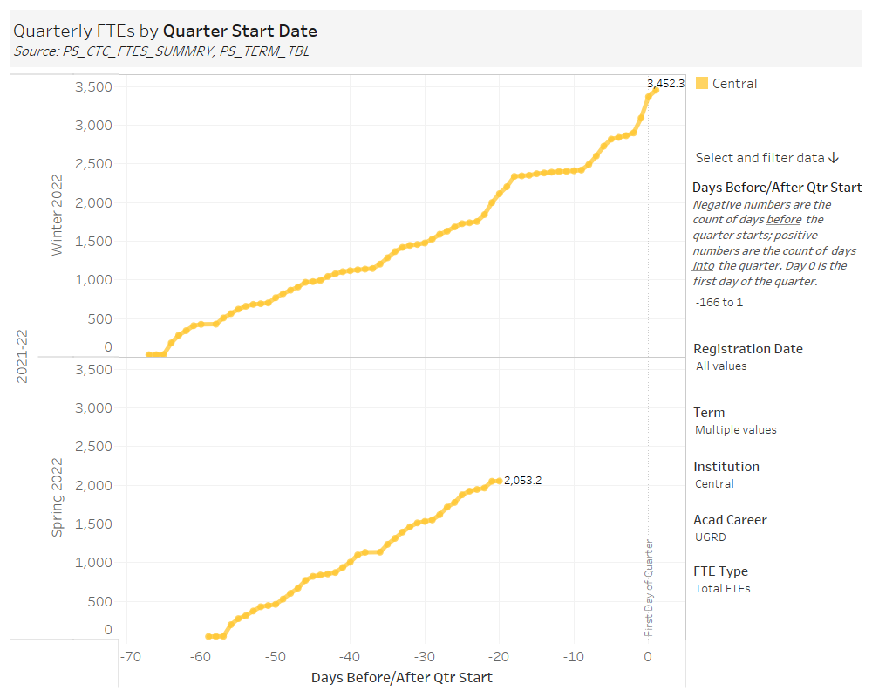

Slide 15
Accreditation Update
October 2021 – Submitted an ad-hoc report to NWCCU on two recommendations from our 2019 visit:
Recommendation 4 on providing facilities that are safe and secure
Recommendation 5 on curriculum monitoring and assessment system to monitor student learning outcomes across courses, degrees and programs
February 2022 – Both recommendations were fulfilled and we have satisfied the recommendations!

Slide 16
We Appreciate You!
Dean Dr. Malena Yanos
Arts, Humanities, and Social Science
Dean Ton Yazici
Seattle Culinary Academy
New Dean Aimee LePage
Seattle Culinary Academy
Dean Dr. Barry Robinson
Healthcare and Human Services
Instructional Support Staff

Slide 17
STUDENTS!
Sydney Hilzendeger, second quarter Culinary Arts student, won the Jeune Commis des Rotisseur Competition held on March 3rd at Renton Technical College. She will move on to compete in the finals in Atlanta!
Chef Varin Keokitvon
Notes:
Chef Varin Keokitvon (Ver - in - like very without the "y" Kee-o-kit-von) was instrumental in 1) bringing back student culinary competitions after a long hiatus and 2) supporting Sydney Hilzendeger (Hill - zen - deg – er) and Edgiemeh (Edgy - may) Dela-Cruz in this competition.

Slide 18
Thank You
Q & A
This is being recorded and will be available on our website within 4 business days

