Slide 1
June 2021 Town Hall Meeting
June 14, 2021

Slide 2
Overview
Kudos
Return to Campus Planning
Budget Update
Guided Pathways
Q&A

Slide 3
Kudos!!
Believe Gala raises over $400,000
Juneteenth Celebration
Dr. Yoshiko Harden accepted into Aspen Rising Presidential Fellowship
End of year celebrations and graduations
Notes:
Reminder to volunteer for drive-through graduation 6/19 3p

Slide 4
Return to Campus Planning
Turning dial with Together Tuesdays starting 6/22
Governor trying incentives instead of mandating vaccines for higher education
Waiting for new directives on contact tracing, distancing, masks and cleaning
June 30 state re-opening but summer will continue to be mostly remote, with some personnel returning to work
Planning for full return to campus in Fall
Notes:
Reminder about visiting campus - Submit return to work plans if new personnel will be returning to campus
Technology distribution continuing to happen through library with online sign-up
State Agencies clarifying when their essential personnel and personnel serving the public qualify for vaccine distribution in the state distribution plan

Slide 5
Budget Update
Seattle Colleges will use reserves to balance FY21-22 budget
Board approved continuing resolution for FY21-22 budget at 6/10 meeting and are expected to vote on final budget in September
$14 million gap between revenue and expenses, plan to cover with $4 million in local fund reserves/reductions and $10 million in one-time federal funds
System plan to close the gap over 3 years
Notes:
Legislative session ended with better than expected budget for higher education
Compensation still an issue, with no COLAs except for I-732 (faculty and classified staff at technical colleges), those given in FY20-21 for exempt staff rescinded
New money for Guided Pathways, worker retraining in high demand fields
Community and technical colleges have been given authority to offer computer science bachelors degree
Reminder that International, Running Start and general enrollment are all down so even with better state budget, we still have a deficit
One time funding (stimulus) are keeping us from having to make additional cuts this year, but we will be submitting a three year plan to the board on how we plan to address the deficit, included 2-3% reduction in FY21-22

Slide 6
Budget Update
At Central we are targeting savings of $2.5 million in FY21-22
For FY20-21, will pull in how much we spent
Legacy FMS query & ctcLink equivalent account
Business office has created a new tool and will train departments how to use it
Business office will propose spending authority by department
Start with FY20-21 authorized budget
Look at historic spending trends & actual FY20-21 outlays
Set FY21-22 spending reductions
Notes:
Assumptions:
2.8% tuition hike (statewide)
Flat FTE enrollment, slight decline in international
Subsidy from Central and North for apprenticeship costs
One-time stipends for AFT faculty & essential classified staff

Slide 7
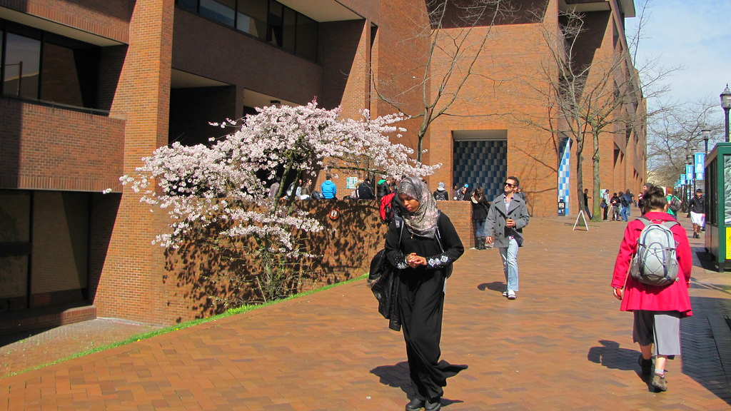
Guided Pathways
May 2021
This Photo by Unknown author is licensed under CC BY-NC-ND.

Slide 9
Priorities for 2021-22
Onboarding students to the college with a seamless admissions, registration, and financial aid process.
Creating clear program pathways, with possibilities for exploration and choice, so that students know what courses to take, and in what order.
Helping students explore careers and programs with redesigned web pages.
Exploring Math Directed Self-Placement and refining the English Directed Self-Placement tool that launched with great success in April 2020.

Slide 10
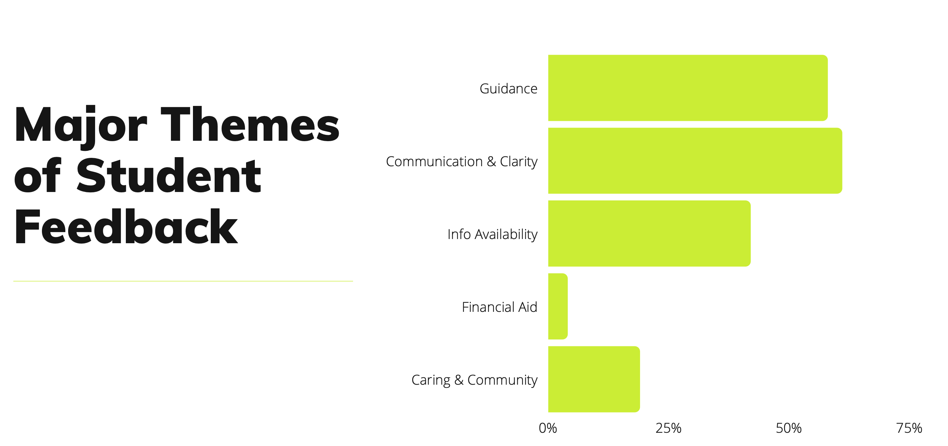
Student Voices
Notes:
Over the last year, we have endeavored to live up to the mantra "nothing for students without students."
We have been engaging students about Guided Pathways and other student success projects from the Student Voices Committee for African American and Black males and the Associated Student Council Leaders.
Dennis Denman, Kate Krieg, and over a dozen faculty and staff have talked with students for 60+ hours in student focus groups about how we can improve their experiences at SCC and close opportunity gaps.
Students have expressed that they have felt heard, and that it's been empowering for them to have access and input about practices and policies at the college for themselves and future students.
Analysis of the focus groups has identified 5 main areas that need improvement:
Quotes that illustrate the feedback topics:
Guidance - "Education planning is very important- knowing what you have to do to graduate. Really being able to visualize how far along you are in your goals, degree, and education really helps you make it through."
Communication and Clarity - "Communication was not timely and there were no directions from anyone about what steps were required or needed for the student onboarding process."
Information Availability - "The big problem at Central is finding the resources. It feels like things are there, you just have to go and find it. It seems like you find these resources after you’ve already stumbled and you don’t need it anymore."
Financial Aid - "Last quarter, Financial Aid didn’t get back to me until the quarter was over and I had already f

Slide 11
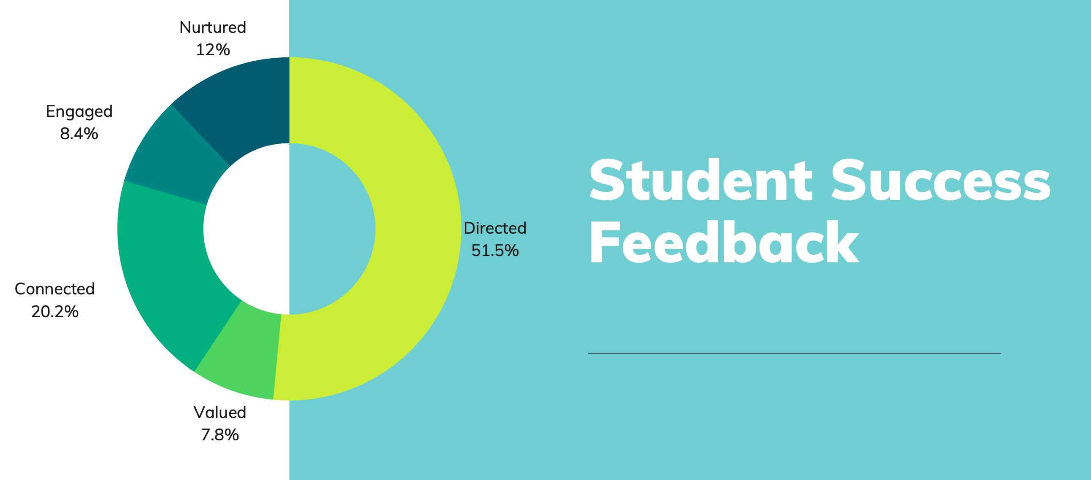
Student Voices
Notes:
We have also analyzed the feedback and recommendations according to 5 student experiences that are critical to student success. This pie chart represents the values students seek most.
Directed - Students have a goal and know how to achieve it.
Nurtured - Students feel someone wants to help them and wants them to succeed.
Valued - Students feel that the college has high standards and expectations for them, and lowers barriers that delay their progress or momentum.
Connected - Students feel that they are part of a community and feel connected to peers.
Engaged - Students feel actively engaged in class and student life.
12 immediate actions were taken to address some of the student feedback and that is a credit to all the faculty and staff who visited with students and acted on the students' feedback, like CCC+ subcommittees, Institutional Research, Title III Work Groups, Guided Pathways Work Groups, Counselors, and the Communications Department.
Students have identified 40 recommendations. Next steps are to map out the actions that are currently addressing the recommendations or, need to be taken. And, next year's Guided Pathways funding will go toward addressing the recommendations.
Additionally, next year's Guided Pathways work with students will focus on their recommendations and our co-accountability for action and communication to students and campus about our progress.

Slide 12
Other Updates
The Black Solidarity Think Tank is finalizing its mission and vision, and working with Dr. Derrick Brooms, the Fall keynote speaker, to build a Learning Institute.
The Black Solidarity Think Tank introduced a racial equity tool in Spring 2020. Since then, it has been used by 14 work groups or areas working on Guided Pathways or student success efforts, such as the revised College Success course (HDC 101), program mapping, First Year Experience, and remote teaching and learning.
Making some changes to the Guiding Team structure for next year
Notes:
Thank you to everyone who served on Guiding Team this year. Even though we were remote, you were engaged, and we thank you for your service and leadership.
We're at a point to evolve the Guiding Team structure for next year. Although we put out a call for faculty interest, no one applied. The Lead Team recognized committee fatigue and discussed if we could achieve our goals to engage faculty and staff in a way that honors all our workloads.
To that aim, Guiding Team will change next year in the following ways:
Once per quarter, Work Groups, which have a diverse mix of faculty and staff, will meet collectively to problem solve, take action, and "connect the dots" among all our efforts.
Once per quarter, Executive Leaders will meet with project Leads, who are faculty and staff, to maintain laser focus on equity in our work, and help solve any barriers or challenges they are facing and give them the support they need.
We will use the May meeting to celebrate our wins and have fun.
We will not meet in December due to the holiday.
We will continue to communicate about Guided Pathways to the campus community through college forums, the Griot, email, President's Day, Professional Development Days, the Pathways website, and department meetings.

Slide 13
Thank You
Q & A
This is being recorded and will be available on our website

