Slide 1
May 2021 Town Hall Meeting
May 18, 2021

Slide 2
Overview
Kudos
Return to Work Survey Results
Return to Work Planning
Budget & Legislative Update
Guided Pathways
Q&A

Slide 3
Kudos!!
IT, Student services and cashiering for in person services
OSP team for ongoing and new partnerships
EHS, Security, Custodial, Facilities/Maintenance and Door Monitors for continuing to keep campus safe during remote operations

Slide 4
Return to Campus-Survey Results
1,480 respondents from Central
Sent directly to students early May

Slide 5
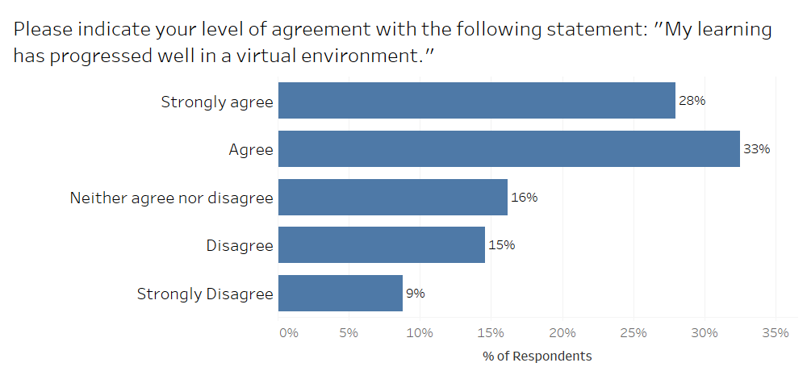

Slide 6
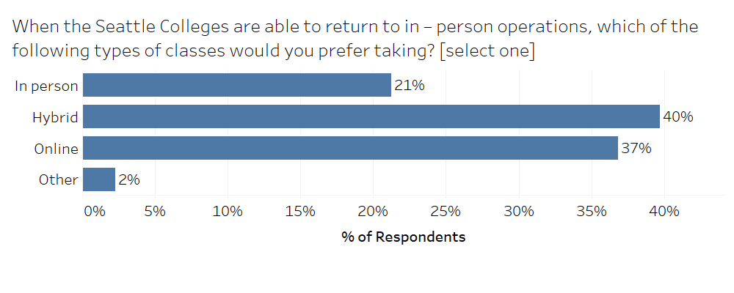
Common open-ended responses:
Unsure, depending on conditions and vaccines
Keep in person optional
Suggestions for different versions of hybrid models for clinicals, labs etc.

Slide 7
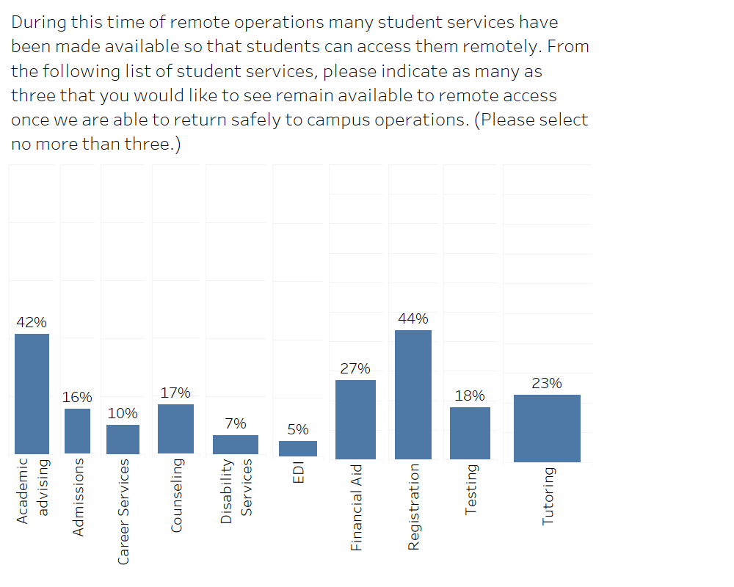
Common open-ended responses:
Students wanting all services to remain remote
Comments re: not being able to access currently available services

Slide 8
Return to Work Planning - Questions
Will Central have the capacity for a full reopening in fall?
Will we require masks on campus even if it is not required by the state?
Other colleges are requiring vaccinations, but we are not. Why?
Will vaccinations be required? Will there be a requirement to prove vaccination status?
Those who are immuno-compromised are still at risk. What are plans to accommodate them?
Will we begin to allow broader activity under a general return to work (RTW) plan for an office or program, or does each activity require a separate request to Health and Safety?
When will we know the plan for fall quarter?
How is the air quality and ventilation in the BE building (and other college areas) being monitored and improved and how does this impacts Covid safety on campus?

Slide 9
Return to Work Planning
Governor to mandate vaccines for all of higher education
Expected to include guidance on distancing, masks and cleaning
We are offering in person study tables, computer lab and limited F2F student services this quarter
June 30 state re-opening but summer will continue to be mostly remote, with some personnel returning to work
Planning for full return to campus in Fall
Notes:
Reminder about visiting campus - Submit return to work plans if new personnel will be returning to campus
Technology distribution continuing to happen through library with online sign-up
State Agencies clarifying when their essential personnel and personnel serving the public qualify for vaccine distribution in the state distribution plan

Slide 10
Budget & Legislative Priorities
Legislative session ended with better than expected budget for higher education
Compensation still an issue, with no COLAs except for I-732 (faculty and classified staff at technical colleges), those given in FY20-21 for exempt staff rescinded
New money for Guided Pathways, worker retraining in high demand fields
Community and technical colleges have been given authority to offer computer science bachelors degree
Reminder that International, Running Start and general enrollment are all down so even with better state budget, we still have a deficit
One time funding (stimulus) are keeping us from having to make additional cuts this year, but we will be submitting a three year plan to the board on how we plan to address the deficit, included 2-3% reduction in FY21-22
Notes:
Governor’s budget released in December includes new investments to advance equity ($23M), job skills training ($10M) and expand high demand degree production ($4M). It also includes a number of compensation-related reductions including cancellation of 2020 wage increases ($40M), furloughs ($66M), health insurance rate increases ($3.8M) and suspension of I-732 COLAS ($25M)

Slide 11
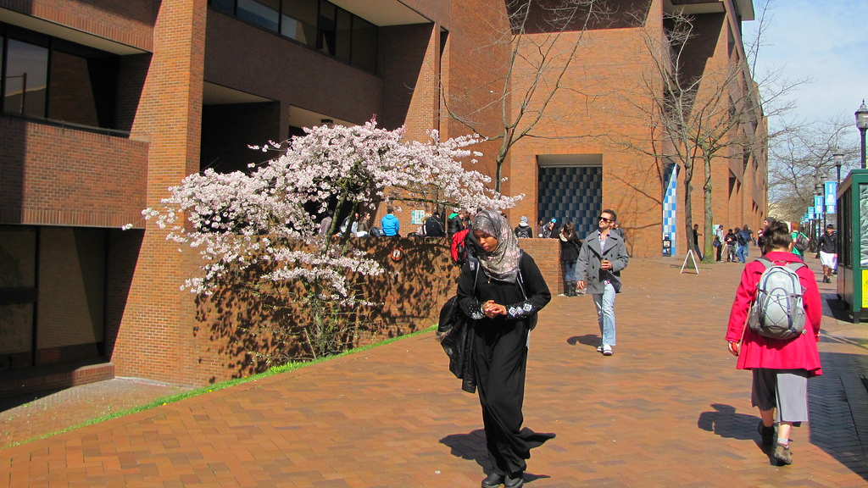
Guided Pathways
May 2021
This Photo by Unknown author is licensed under CC BY-NC-ND.

Slide 12
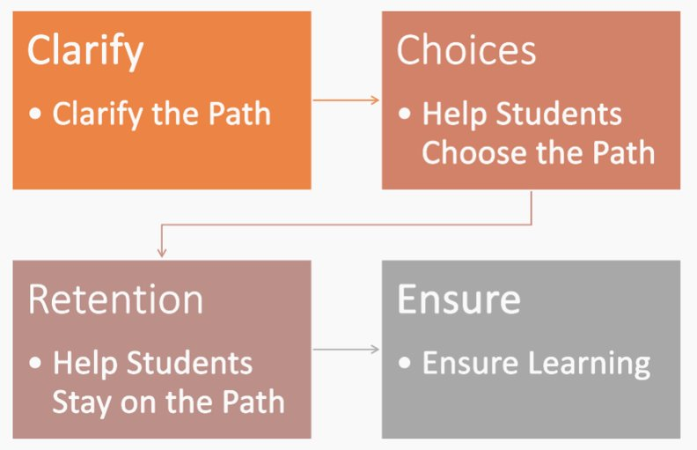

Slide 13
Planning for 2021-22
Seattle Central will have Guided Pathways funds next year to continue our good work and momentum toward increasing our retention and completion rates, particularly for historically underserved students.
Our work continues to be in the service of closing opportunity gaps. The Black Solidarity Think Tank's framework and racial equity tool will continue to be used in our Guided Pathways projects and related student success work.
If you are faculty, part-time or full-time, and would like to be part of Guided Pathways, consider filling out the faculty interest form to serve on Guiding Team. The form is in your email, sent by Kate Krieg, interim Executive Director of Guided Pathways. Or email Kate directly for the link to the form.

Slide 14
Priorities for 2021-22
Onboarding students to the college with a seamless admissions, registration, and financial aid process.
Creating clear program pathways, with possibilities for exploration and choice, so that students know what courses to take, and in what order.
Helping students explore careers and programs with redesigned web pages.
Exploring Math Directed Self-Placement and refining the English Directed Self-Placement tool that launched with great success in April 2020.

Slide 15
Thank You
Q & A
This is being recorded and will be available on our website

