Slide 1
April 2021 Town Hall Meeting
April 12, 2021

Slide 2
Overview
Kudos
Safety Messaging
Enrollment Update
Return to Work Planning
Budget & Legislative Update
Guided Pathways
Q&A

Slide 3
Kudos!!
Seattle Promise team
CTC-Link team
Student services and cashiering for in-person services
Notes:
Seattle Promise outreach and retention teams – 2100 applications (500 more than last year). 1242 designated Central. Also 80% Fall to Winter retention rate for 2020 cohort at Central And 71% Fall to fall retention for the 2019 cohort
Ctc-Link team – huge kudos and thank you. We knew it would be difficult. Challenges but no surprises.

Slide 4
Campus Safety/Messaging
Clery reporting requirements
Recent messaging with picture and equity concerns
Recent meeting with 12th precinct and limits on their ability to hold suspects other than DUI and domestic violence charges
Safety upgrades continue (cameras, lighting, escorts)
Security Office phone number: 206-934-5442
Upcoming safety course
Implementation of prox card system

Slide 5
Enrollment Update
Monitoring impact of ctc-Link conversion
Student services Vice Presidents are implementing plan to enhance outreach for Fall 2021 enrollment
Continue to watch international enrollment and impact of federal policy, travel restrictions and reopening of embassies

Slide 6
Return to Work Planning
Governor may announce that some counties revert to Phase 2 today, but not expecting King County to be in that group
New CDC guidance on distancing and cleaning, waiting for WA Dept of Health and Labor & Industries to weigh in on higher education
We are offering in person study tables, computer lab and limited F2F student services this quarter
Summer will continue to be mostly remote, with some personnel returning to work
Planning for a more full return to campus in Fall/Winter
Notes:
Reminder about visiting campus - Submit return to work plans if new personnel will be returning to campus
Technology distribution continuing to happen through library with online sign-up
State Agencies clarifying when their essential personnel and personnel serving the public qualify for vaccine distribution in the state distribution plan
CEC reviewed the telework policy in this morning’s meeting

Slide 7
Budget & Legislative Priorities
Legislative session almost complete with much better revenue forecast than expected impacting budget proposals from the House and Senate
No COLAs except for I-732 (faculty and classified staff at technical colleges), those given in FY20-21 delayed until July 2021
Community and technical colleges have been given authority to offer computer science bachelors degree
International, Running Start and general enrollment are all down so even with better state budget, we still have a deficit
One time funding (stimulus) are keeping us from having to make additional cuts this year, but we have to submit a three year plan to the board on how we plan to address the deficit
College Council’s resource allocation committee is finalizing budget principles for 2021-22 budget
Notes:
Governor’s budget released in December includes new investments to advance equity ($23M), job skills training ($10M) and expand high demand degree production ($4M). It also includes a number of compensation-related reductions including cancellation of 2020 wage increases ($40M), furloughs ($66M), health insurance rate increases ($3.8M) and suspension of I-732 COLAS ($25M)

Slide 8
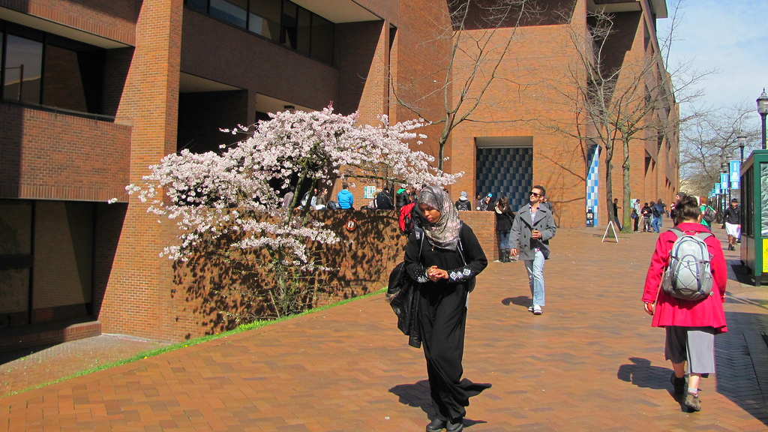
Guided Pathways
April 2021
This Photo by Unknown author is licensed under CC BY-NC-ND.

Slide 9
Guided Pathways is a deliberate and comprehensive institutional mechanism to achieve two Operational Plan goals:
Student Success
Diversity, Equity, Inclusion, and Community

Slide 10
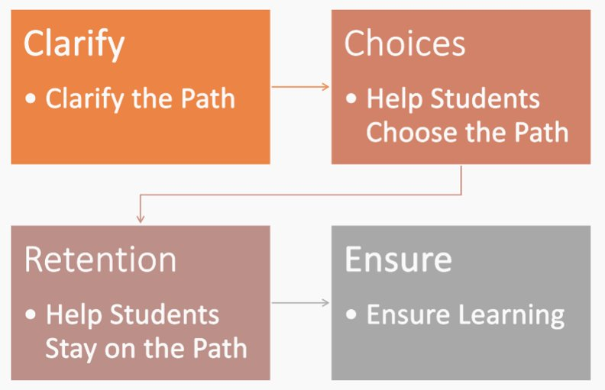

Slide 11
8 Guided Pathways Work Groups
Central Lead Team
Central Guiding Team
College Success Course
Exploratory Mapping
Intake & Onboarding
English DSP
Black Solidarity Think Tank
Mapping and Ensuring Learning
Student Voice
Equity in Practice

Slide 12
Black Solidarity Think Tank & PDD Partnership
Fall- Dr. Derrick Brooms
Winter- Dr. Sankofa Waters
Spring- Dr. Frank Harris III (upcoming)
*recordings available on 20/21 Dev Day Canvas shell*
College Success Course
Relaunching Fall 2021
Course Data Dashboard
Transparency to help us explore and close opportunity gaps
English Directed Self-Placement
1,542 students
94% placed into college-level English versus 43% pre-DSP
New Educational Planner, BTS Completion Navigator, Advising hourly workers
Faculty Invitation for Guiding Team 2021-23 (AY)
See email from kate.krieg@seattlecolleges.edu

Slide 13
Thank You
Q & A
This is being recorded and will be available on our website

