Slide 1
January 2021 Town Hall Meeting
January 8, 2021

Slide 2
Overview
Welcome King County Health
Civil Unrest Impact on Campus
Return to Work Planning
Budget & Legislative Priorities
ctc-Link February Conversion
Student Networking Event
Q&A

Slide 3
King County Public Heath
Stacey Brant, RN
Christiann Staphf, DPH/PD/ID
Communicable Disease Epidemiology & Immunization Group

Slide 4
Impact of Civil Unrest on Campus
CHOP & over 7 months of protests since May
November Election
Cal Anderson
Presidential Transition

Slide 5
Return to Work Planning
K-12 districts slowly returning to in person instruction with youngest students
Districtwide team working on decision factors related to reopening campus underway (roll out of vaccine, # of cases in community, ability to adhere to cleanliness guidelines, availability of PPE)
As we think about Spring, planning to be mostly remote
Projections are for things to open up more after June, so we will be turning the dial for more in person activity after that

Slide 6
Return to Work Planning
Throughout Winter Quarter:
Submit return to work plans if new personnel will be returning to campus
Technology distribution continuing to happen through library with online sign-up
State Agencies clarifying when their essential personnel and personnel serving the public qualify for vaccine distribution in the state distribution plan

Slide 7
Budget & Legislative Priorities
Governor’s budget released in December includes new investments to advance equity ($23M), job skills training ($10M) and expand high demand degree production ($4M). It also includes a number of compensation-related reductions including cancellation of 2020 wage increases ($40M), furloughs ($66M), health insurance rate increases ($3.8M) and suspension of I-732 COLAS ($25M)
Legislative session starts next week, we can expect debate over many of these investments/reductions as well as introduction of new taxes/revenue proposals
International enrollment is down 60% so projected revenue loss from that is higher than expected
CARES II funding

Slide 8
ctcLink is Coming
CTC go-live February 22nd means major changes in HR, Enrollment and Financial data processes
Many of us are involved in training and user testing, so remember patience and grace for colleagues
Many non-service dates
Jan 15–March 8 E-forms disabled and no new requisitions in NeoGov
Feb 8–March 1 No financial aid, scholarship or emergency funding disbursements
Feb 10–March 1 Cashiering closed
Feb 12 TLR for 2/1-16 must be entered
Feb 12-22 Admissions portal will close
Feb 22-26 Payroll, Accounting, College Business Offices, Enrollment & Registration, Admissions, and Financial Aid Offices closed on all campuses

Slide 9
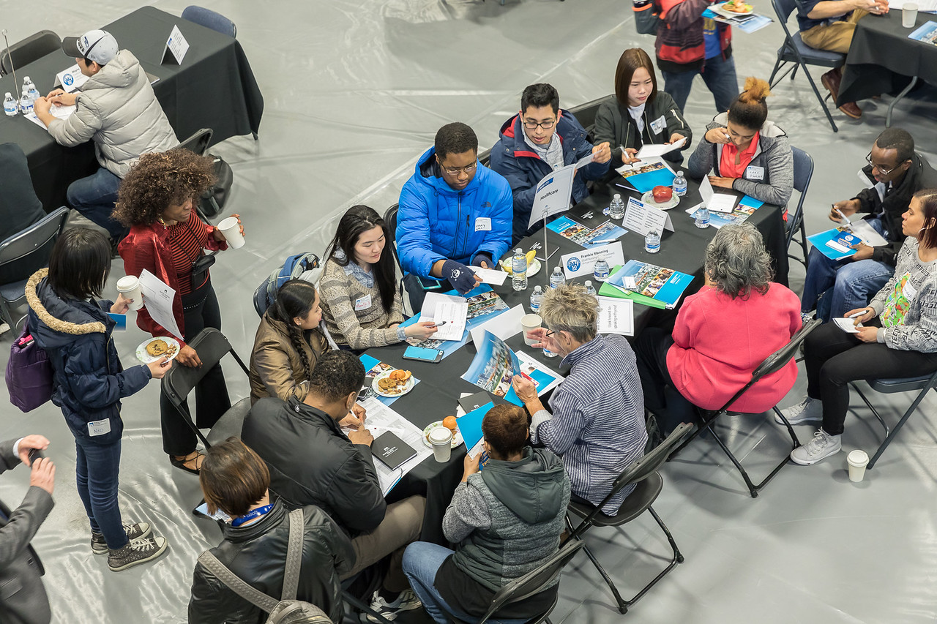
Connect Central: Virtual Speed-Networking Week Jan. 25 – 28, 2021
Students network with community, business and industry leaders.
Three 15-minute speed-networking rounds per session
Each day focuses on a different set of career pathways based on areas of study
Students and classes are encouraged to sign up
OSP & CEC offering short trainings for classes to prep students
More information and sign-up at: seattlecentral.edu/connectcentral
Notes:
I hope you will consider incorporating the college’s annual speed networking event into your curricula and/or offering extra credit. Scheduled for Jan 25 – 28, this is a great opportunity in alignment with Guided Pathways for students to meet with professionals to explore and inform career paths. You can RSVP your class here. The Career Exploration Center and OSP are also offering classes 10-15 minute networking trainings prior to the event so your students can come prepared to make the most of this opportunity. Sign up for these trainings also in the RSVP form. For questions, please email Emily.thurston@seattlecolleges.edu

Slide 10
Thank You
Q & A
This is being recorded and will be available on our website no later than end of day tomorrow

