Slide 1
Synchronous Communication

Slide 2
Synchronous Communication Tools
Text-based
Chat Chat within LMS
Skype
AIM/MSN/Yahoo
Audio Only Chat
Telephone
Free Conference Call
Skype
Zoom
Multi-modal Tools
Zoom
Blackboard Collaborate
WebEx
Google Hangouts
Adobe Connect

Slide 3
Reason & Purposes for Synchronous Tools?
Reasons for Choosing Synchronous
More Personal.
Helps students with different learning styles.
Ability to cover more material in a shorter amount of time.
Ability to have spontaneous discussions/responses.
Purposes for Choosing Synchronous Sessions
Office Hours.
Course Lectures / Class Discussion.
Introduction to Major Assignment / Project.
Guest Speakers / Panels.
1-on-1 Meetings w/Students.
Student Group Project Meetings.
Student Presentations.
Course / Program Orientation.
Application Demo.
Virtual Computer Lab.

Slide 4
Managing the Chaos!
Structure
Plan Ahead
Have a Script / Outline
Practice
Desktop & Laptop (1 as Moderator & 1 as Student)
Provide Expectations
Arrive Early & Setup
Have a Backup Plan
Mail Presentation ahead of Time
Conference Call
Interactions
Mute Microphones by Default
Ask Participants to Keep Side Chats to a Minimum
Question & Answer Periods
Raise Hand
Type question
Don’t hit Enter until Called Upon
Assign Students Numbers & Align Activities w/Them.

Slide 5
ABOUT ZOOM
Double Click the Video to the Right to Start
Zoom Account
https://zoom.us
Web Conferencing Tool
Your Pro Account
Pro Account
100 Participants / Meeting
Link Can Be Put in Your Canvas Course for Student Access
Your Pro Account
https://support.zoom.us/

Slide 6
Set Your Personal Meeting ID
Double Click the Video to the Right to Start
Personal Meeting ID
Assigned Automatically.
Start it Anytime or Schedule it.
Personal Meeting URL; https://zoom.us/j/5551112222
You can customize the 10 digit ID (See Next Slide)

Slide 7
Customizing Your Personal Meeting ID
Zoom Account
Log into https://zoom.us
Click My Profile
Personal Meeting ID Section
Click Edit
Work Phone Number Recommended
Highlight, Copy, Paste into Canvas Course.
Support Information
https://support.zoom.us/hc/en-us/articles/201362843-What-is-Personal-Meeting-ID-PMI-and-Personal-Link-

Slide 8
Downloading The ZOOM Client
Zoom Account
https://zoom.us
My Profile
Personal Meeting ID
Edit
Work Phone Number Recommended
Support Information
https://support.zoom.us/hc/en-us/articles/201362843-What-is-Personal-Meeting-ID-PMI-and-Personal-Link-

Slide 9
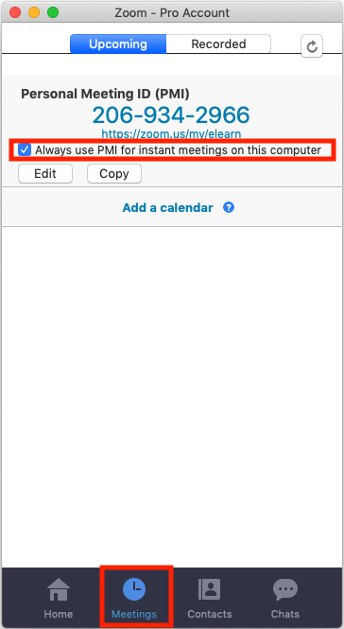
Starting a Meeting from the ZOOM Client
Zoom Client Strategies
Want to have all Meetings Use Your Personal Meeting ID?
Click on Meetings Tab
Check “Always Use PMI for Instant Meetings on this Computer”
Click Start Meeting on Home Tab.
Note: This will have to be done on each computer you use.
Support Information
https://support.zoom.us/hc/en-us/articles/201362033-Getting-Started-on-PC-and-Mac

Slide 10
Checking Audio / Video
Double Click the Video to the Right to Start
Zoom Client Strategies
Click Test Computer & Mic Speakers.
Confirm Correct Audio & Video Devices are Selected.
Click Test Speaker
Click Test Mic
Click Join Audio Conference By Computer.
Support Information
https://support.zoom.us/hc/en-us/articles/201362283-How-Do-I-Join-or-Test-My-Computer-Device-Audio-

Slide 11
Zoom Environment: Toolbar
Another way to access Meeting Controls.
Meeting Menu
Enter Full Screen
Mute All
Unmute All
Join Audio
Start Video
Start Share
Invite
Show Manage Participants
Show Chat
Record on this Computer
Record to the Cloud

Slide 12
Zoom Environment: Recording Your Meeting
Double Click the Video to the Right to Start
Recording Options
Record Locally to Your Computer.
Record to the Cloud.
Please Record Locally – We can Upload to Your Canvas Classroom After if Needed.
Support Information
https://support.zoom.us/hc/en-us/articles/201362473-Local-Recording

Slide 13
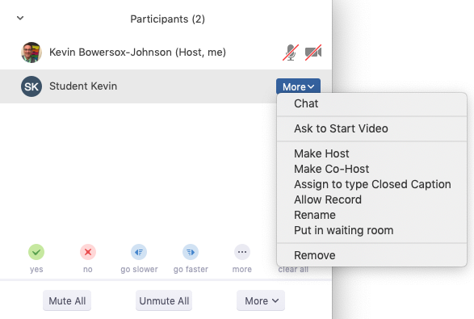
Zoom Environment: Manage Participants
Managing Participants
Window: Displays on the right – Floats when in Full Screen Mode.
Chat: Start a private chat with this person.
Stop Video: Stop the participant's video stream so they are unable to start their video. If the participant hasn't started their video, you will see the Ask to Start Video option.
Make Host: Assign the attendee to be the host. There can only be one host.
Make Co-Host: Assign the attendee to be a co-host. You can have an unlimited number of co-hosts. Learn more.
Allow Record: Allow the attendee to start or stop a local recording of the meeting. Attendees do not have access to start a cloud recording.
Assign to type Closed Caption: Assign the attendee to type Closed Caption during the meeting.
Rename: Change the attendee name that is displayed to other participants.
Put in Waiting Room: Place the attendee in a virtual waiting room while you prepare for the meeting. The host must enable waiting room for this option to appear. Learn more.
Put On Hold: If the waiting room is not enabled, you'll see this option to place the attendee on hold.
Remove: Dismiss a participant from the meeting.
Support Information
https://support.zoom.us/hc/en-us/articles/115005759423-Managing-Participants-in-a-Meeting

Slide 14
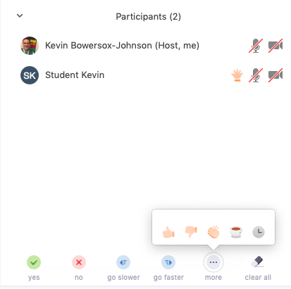
Zoom Environment: Participant Nonverbal Feedback
Participant Feedback
Window: Same as Manage Participant Window; Displays on the right; Floats when in Full Screen Mode; Students See “Participants” on their Toolbar.
Icons:
Raise Hand / Lower Hand
Yes / No
Go Slower / Go Faster
Additional icons are available by clicking the more button:
Agree / Disagree
Clap
Need a Break
Away
Support Information
https://support.zoom.us/hc/en-us/articles/115001286183-Nonverbal-Feedback-During-Meetings

Slide 15
Zoom: Participant Nonverbal Feedback Activity
Chat
Click Participants: Displays on the right – Floats when in Full Screen Mode.
Click Agree or Disagree:
Agree: Zoom is pretty easy to use (thumbs up).
Disagree: Zoom is somewhat difficult (thumbs down).

Slide 16
Zoom Environment: Chat
Chat
Window: Displays on the right – Floats when in Full Screen Mode.
To: The person or group the message will be sent to/seen by.
More: Controls for the Host, including the ability to send files to participants.
Support Information
https://support.zoom.us/hc/en-us/articles/203650445-In-Meeting-Chat

Slide 17
Zoom: Chat Activity
Chat
Click Chat: Displays on the right – Floats when in Full Screen Mode.
Confirm To: Make sure To is set to Everyone – if not, change it by clicking the dropdown box.
Say Hi: Say Hello, your Name, and the subject you teach.
Control the Chaos Tip
Prepare: Ask students to Type Answer without hitting Enter.
Take Turns: Call on students one or two at a time to post – Click Enter.

Slide 18
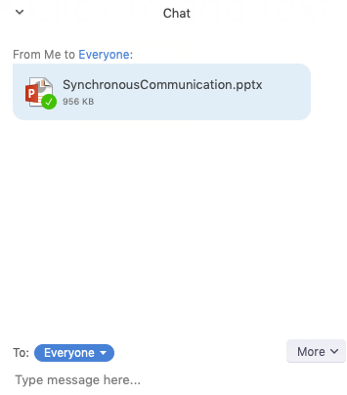
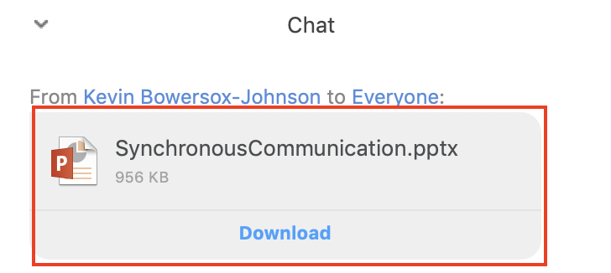
Zoom: Chat / Share a File in Meeting Activity
Instructor
Click Chat: Displays on the right – Floats when in Full Screen Mode.
Click Share File in a Meeting: A dialogue box will display for you to choose file on your computer.
Choose File: Navigate to file, select, and click Open.
Participants
Download: When Prompted, download the file from your instructor.
Open: Follow along with the file, or use for your own notes

Slide 19
Zoom: Share Screen / Program
Share:
Click Share: You can share either your full screen or just one currently open program or file
What to Share?: A dialogue box will display for you to choose what to share
Choose Program: Select the program and click Share Screen
If video: Click Share computer sound to also include the audio playing from the computer. If full screen, select Optimize for full screen video clip—otherwise, leave untoggled
Student Sharing:
Students can share: Students have the same option to share their screens, without being made a co-host
Lock Screenshare: If you do not want anyone else to share their screen, you can restrict the feature to just you

Slide 20
Zoom: Annotate Screen
Annotate:
Click Annotate: Window will move to the top of your screen, with annotation options floating below
Saving: Annotations are not saved automatically, and are part of the shared screen—if annotating a specific slide, for instance, when you advance to the next slide, your annotations will come with you
Student Annotations:
Students can annotate: Students have same annotation options as presenter, except for Select and Save
The Spotlight tool for students becomes Arrow, which puts an arrow with their name onto the screen
The Undo, Redo, and Clear options only work for that students’ annotations—not any annotations made by the presenter or another student
Annotation Options:
Mouse – The mouse tool will give you back control of your screen
Select – The Select tool will allow you to select and move or delete individual annotations
Text – The Text tool will allow you to type onto the shared screen
Draw – The Draw tool will allow you to draw shapes onto the shared screen
Spotlight – The Spotlight tool will turn your cursor into a spotlight or arrow
Eraser – The Eraser tool will allow you to erase select elements of the annotations
Format – The Format tool will allow you to change the format of annotations, including size and color
Undo – The Undo tool will remove your most recent annotation change
Redo – The Redo tool will restore your last undo, provided no change has been made since
Clear – The Clear tool will remove all annotations from the shared screen
Save – The Save tool will take a screenshot of the shared screen, with all annotations

Slide 21
Zoom: Breakout Rooms
Double Click the Video to the Right to Start
Breakout Rooms allow for:
Students to communicate in real time in small groups
Private discussions between instructor and student
Breakout rooms are not part of the main recording, and do not see the main screen share
Support Information
https://support.zoom.us/hc/en-us/articles/206476093-Getting-Started-with-Breakout-Rooms

Slide 22
Zoom: Polling – Create a Poll
Polling:
Polling must be set up on the Zoom website in advance of the meeting
Login to the Zoom.us website and click on My Meetings, then Meeting Management
Find the Poll section and click Add
Enter Title, Polling Question, and Potential Answers
If creating additional questions, click Add a Question and repeat step 4
Choose if participants must choose one answer, or can select multiple
Click Join Audio Conference By Computer.
Support Information
https://support.zoom.us/hc/en-us/articles/201362283-How-Do-I-Join-or-Test-My-Computer-Device-Audio-

Slide 23
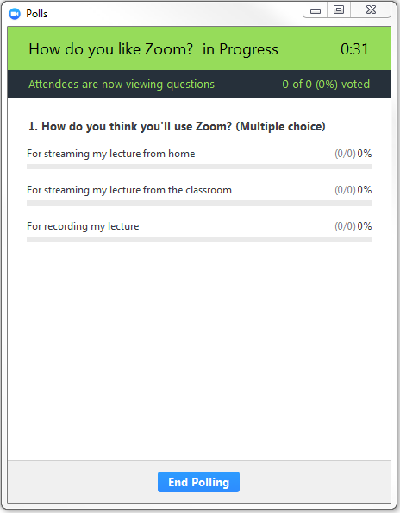
Zoom: Polling – Launch a Poll
Launch:
Click Polls: You can choose from up to 25 created polls
Select Poll: Choose the poll you would like to launch and click Launch Polling
Participants: Select their appropriate answer choice(s)
Real-Time Results: Poll results will appear in real-time on the screen, indicating the percentage of times each answer has been chosen and how many participants have currently answered the poll
Dismiss: Click End Polling to close the poll

Slide 24
Zoom Environment: End Meeting
End Meeting:
Click End Meeting: You may end the meeting, or simply leave it
Ending Meeting for All: The meeting ends and all participants leave the Meeting room. Any recording ends.
Leave Meeting: If you wish the meeting to continue, you may opt to leave the meeting instead of ending it. To do this, you must first have made someone else the meeting host.
Promote Participant to Host:
Manage Participants: Click Manage Participants and choose the participant you wish to promote
Make Participant Host: Hover over the user you wish to promote and click More, then choose Make Host.
You may now leave the meeting.

